Slide 1
Retail Sales Analytics
SQL · BIGQUERY · PYTHON
Business findings and strategic recommendations

Slide 2
Executive summary
THE BIG PICTURE
2,725.39
13,719.95
2020
August
Average order value
Average revenue per customer
Highest revenue year
Best performing month
Revenue is broadly balanced across customers and products, so growth will come from retention and timing rather than one dominant segment.
Retail Sales Analytics · SUMMARY

Slide 3
Customer analysis
WHO BUYS
55+ SEGMENT
50 / 50
198.2M
Revenue is almost equally split between male and female customers
Highest revenue of any age group, and also the largest segment with 13,959 customers.
Male
Male customers have the higher average order value
~20%
Approximately a fifth of customers have churned
Retail Sales Analytics · CUSTOMERS

Slide 4
Product analysis
WHAT SELLS
Home
Clothing
~25% each
Highest revenue at 171.1M, while Books generated the lowest.
Sold the highest quantity and is the fastest-growing category over time.
Revenue is evenly distributed, with each category contributing about a quarter.
Retail Sales Analytics · PRODUCTS

Slide 5
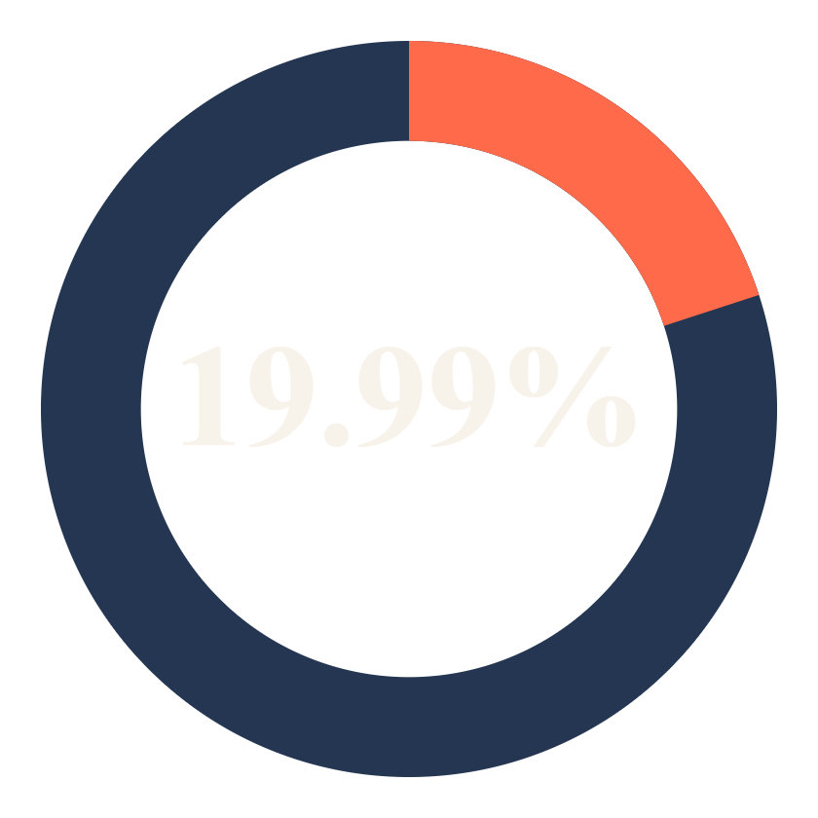
Churn analysis
WHO RETURNS
20.03%
20.07%
Female customers churn most; Clothing is the category with the most churn
Share of total revenue from churned customers
~5 orders
20.69%
Both retained and churned customers average about 5, so frequency alone does not explain churn
Highest churn age group: 18-25
Retail Sales Analytics · CHURN

Slide 6
Protect the revenue base
RECOMMENDATIONS 1-3
1
Prioritize 55+ retention
2
Fix the Clothing churn gap
3
Treat churn as behavior
This segment is both the biggest and the most valuable, so a small loss here costs more than anywhere else. Build a dedicated program: priority service, early access to Home products, simple reorder journeys and a proactive win-back contact when activity slows. Track 55+ churn and revenue per customer monthly.
Clothing is the fastest-growing and highest-volume category, yet its customers churn the most. Growth that leaks is expensive. Survey recent Clothing churners, review sizing, returns and delivery experience, and add post-purchase follow-ups so new buyers become repeat buyers.
Equal order counts mean frequency is not the signal. Look at recency, basket mix, discount use, returns and support contacts instead. Use these to define at-risk triggers, then test a retention offer against a holdout group to prove it works.
Retail Sales Analytics · REC1

Slide 7
Grow where momentum exists
RECOMMENDATIONS 4-6
4
Engage 18-25
5
Invest in Clothing, with guardrails
6
Plan the year around August
This group has the highest churn at 20.69%. Test social-first campaigns, first-purchase offers, referral rewards and a fast mobile checkout. Measure second-purchase rate within 90 days as the key success metric.
Back the category with range depth, size availability and targeted marketing, but scale spend only as retention improves. Pair acquisition budget with the churn fixes so each new customer has a better chance of staying.
August is the strongest month, so build stock and campaigns ahead of it. Secure supplier capacity in spring, launch teasers in July, and staff service and fulfilment for the peak. Study 2020 as the benchmark year.
Retail Sales Analytics · REC2

Slide 8
Build durable systems
RECOMMENDATIONS 7-9
7
Predictive churn model
8
Loyalty program
9
Rebalance the portfolio
Use BigQuery and Python to score customers on churn risk with recency, category, age band, order value and engagement features. Refresh scores weekly and send the highest-risk, highest-value customers into retention campaigns first.
Tier rewards by value so 55+ and high-spend customers feel recognized, while a low-barrier entry level draws in the 18-25 group. Compare retention and order value for members against a control group before wider rollout.
Revenue is evenly split, so no category is dispensable. Review Books for pricing, bundling or cross-sell with Home rather than dropping it, and use the gender difference in order value to tailor offers and merchandising.
Retail Sales Analytics · REC3

Slide 9
Suggested roadmap
NEXT 180 DAYS
Days 0-30
Days 30-90
Days 90-180
Investigate Clothing churn, define at-risk signals and set baseline KPIs by segment and category.
Launch the 55+ retention program and 18-25 pilot, and prepare the August plan.
Deploy the churn model, pilot loyalty tiers and run the August campaign.
SUCCESS MEASURE
SUCCESS MEASURE
SUCCESS MEASURE
Baseline churn by segment and category
Lower 55+ churn and a higher 18-25 second-purchase rate
Retention uplift vs control and August revenue vs 2020
Validate each initiative with a control group so the SQL findings become proven, repeatable gains.
Retail Sales Analytics · ROADMAP

